Slide 1
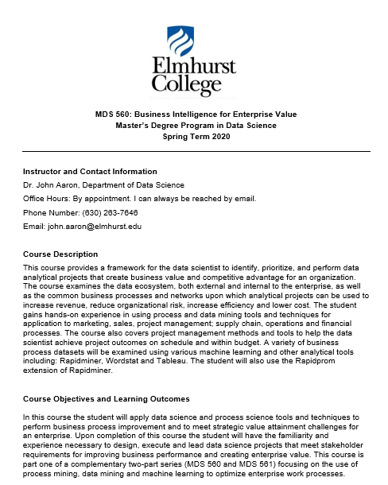
Note: Every Thursday 7:00 PM to 9:30 PM
Exception Class #6 Will Be Held a Day Early on Wednesday May 6th 7:00 PM to 9:30 PM.

Slide 2
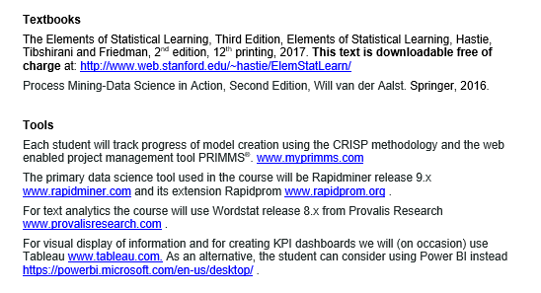
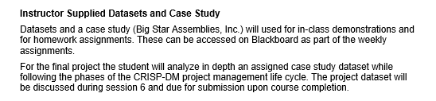

Slide 3


Texts Chosen
Downloadable-Free of Charge

Slide 4
MAC USERS
Rapidminer Users With MACS
……your students should not be having issues using RapidMiner on a Mac - many RapidMiner users have Macs and have little to no issues at all. I recommend that you post your question on the RapidMiner Community (https://community.rapidminer.com/), explaining what the exact issues are that your students are facing. I have already spoken to my colleague, Scott Genzer, about the issues you are facing, so he will be looking out for your post if you decide to post your question on the Community.

Slide 5
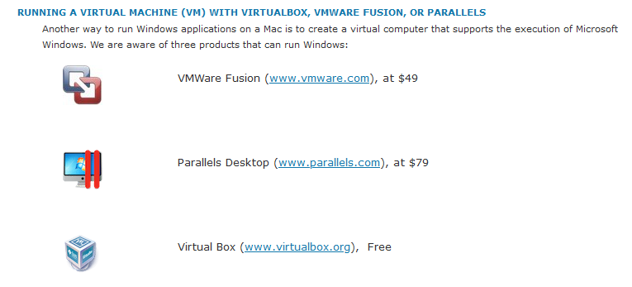
Wordstat Users With MACS frequently have issues. This applies to one homework assignment. It is recommended that you install
https://provalisresearch.com/products/simstat/simstat-technical-information/mac-os/

Slide 6
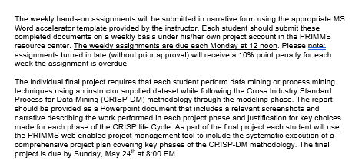
The final project will be due by Sunday, May 24th at 8:00 PM (the evening before Memorial Day).

Slide 7
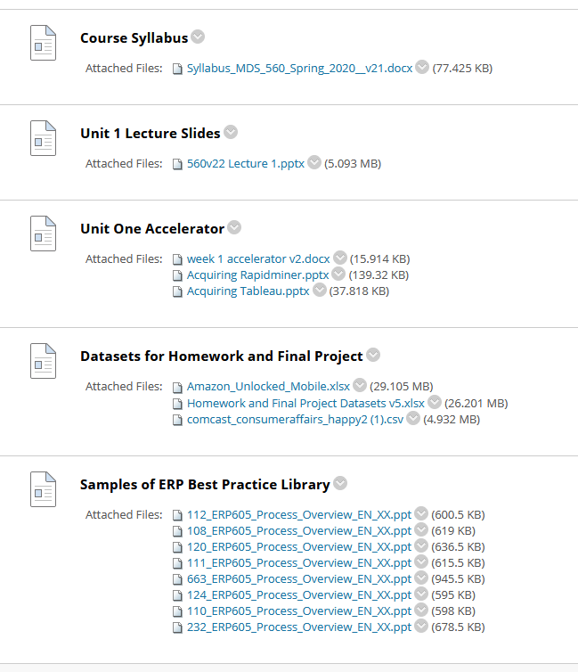
These files have been updated this week.

Slide 8
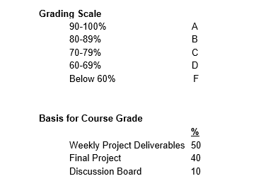

Slide 9
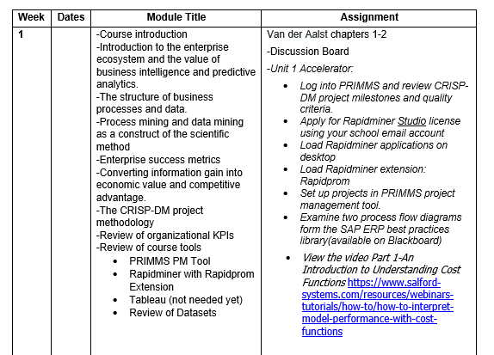
This Week

Slide 10
Systems Model of the Organization and The Concept of Business Value
Effectiveness Feedback
Voice of the Customer Feedback (VOC)
Goals
?
?
?
Value to The
Customer and Expectations of the Customer
?
?
Inputs
?
?
Outputs
?
?
?
?
?
?
?
?
?
?
?
?
?
?
The Organization
?
?
?
?
?
?
?
?
?
?
?
?
?
?
?
?
?
?
?
Efficiency Feedback

Slide 11
General
Environment
Operating Environment
Effectiveness Feedback
Goals
Inputs
Outputs
Sales
Dept.
Finance
Dept.
IT
Dept.
IT Dept.
OPS
Dept.
Shipping
Dept.
Internal Environment
Efficiency Feedback

Slide 12
Expanding further and including within the ecosystem:
The Internet of Things
Using structured and unstructured data
General
Environment
Stockholders
Regulatory Agencies
Operating Environment
Effectiveness Feedback
Goals
Creditors
Channel
Partners
Inputs
Sales
Dept.
Finance
Dept.
Outputs
IT
Dept.
Customers
IT Dept.
Suppliers
OPS
Dept.
Shipping
Dept.
Competitors
Internal Environment
Efficiency Feedback
Employee
Unions
Local Communities
Social Environment
Legal
System
Technological Environment

Slide 13
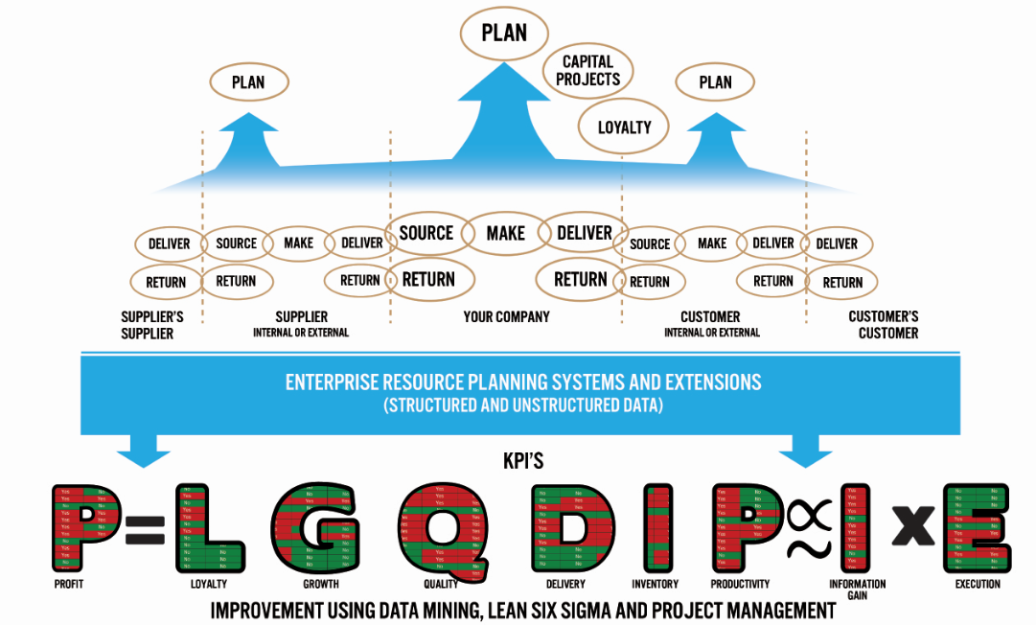
APICS
SCOR Model
Executive Level Management
Business Processes
Big Data
Target Variables
KPI’s Anchor the Process in “Reality”. The Goal is To Identify the “Truth” Related to Actions that Will Optimize the KPI.

Slide 14

The SIPOC Framework Remains Key
Your Company
Sales & Market
HCM
Delivery/ Returns
Supplier’s Supplier
Make/Ops
Customer
Customer’s
Customer
Supplier
Source
Finance
IT
Common KPI’s
Loyalty
Growth
Quality
Delivery
Inventory
Productivity
$
Often the “Token Counter” Approach is a Useful Starting Point. This is foundational to process mining.
This is a variation of the APICS SCOR framework.

Slide 15
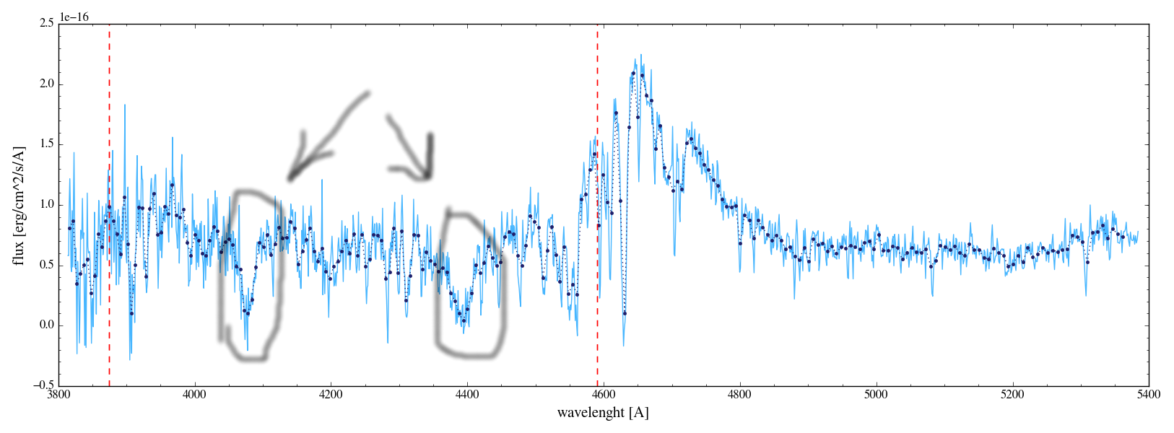
From a Process Perspective
We Have Events and Transitions
Process
Input
Output
Supplier
Customer
Is the Process Highly Visible?
Do You Have a Target KPI History?
Do You Have Historical Explanatory Data? (Transactions and Movements )
Can Explanation and Prediction Be Leveraged to Improve Process Quality and Productivity?
Process Performance Indicator

Slide 16
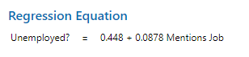
What Do We Mean By Statistical Learning?
EXAMPLE: We would like to determine if users on a social media site who mention the word “job” in their text are likely employed or employed. Current unemployment rate is 3.7%.
Unemployed? = Probability of .037→ Classified “No”
We Analyze
Sample Text
+ Error
With Just 1 Mention of the word “Job” on a user entry, the probability of unemployment is predicted to be 0.53. It is likely the person is unemployed.
We would classify the person as a “Yes” given the evidence
The Maximum Likelihood parameters reflect “Learning” from errors

Slide 17
Statistical Learning In Various Flavors Can Be Helpful
Reinforcement Learning
Process
Closed Loop Control Based Upon Feedback and Feedforward (MDS 562)
Automated
Actions
Input
Output
Supplier
Preventative
Actions
Customer
Process
X Data
Decisions
Predictions Y’
Y
Y=f(X)
Machine Learning
KPI: Process Performance Indicator

Slide 18
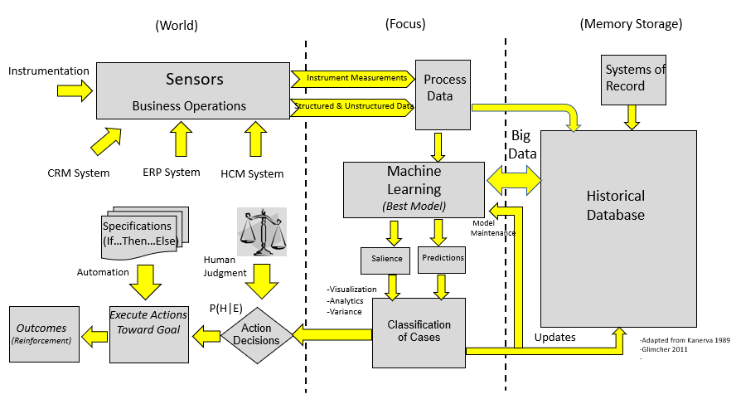
Perception-Action Cycle
A Block Diagram of a System of Intelligence For Enterprise Processes
The Complete Perception-Action Cycle of AI

Slide 19
Case Study: A Micro View
Along with SAP Examples
Project Performance Reporting:
Cost
Scope
Schedule
Quality
Resources
Risk
IT Performance Reporting:
Cost
Outages
System Performance
Incidents
Security
Audits
Projects
Operations Projects
IT Infrastructure & Networks
-Replacement
-Process Improvement
Operations Performance Reporting
ECOMMERCE
Human Capital
Mgmt.

Slide 20
The Environment is Dynamic and Competitive
Competitive Advantage/Disadvantage Depends Upon:
New, Disruptive Technologies Emerging
New Market Entrants Promising Lower Prices/Costs
New Opportunities
Competitive Threats
All Requiring Good Decision Making Given Limited Resources

Slide 21
KPI’s Link Value Creation to Information Gain
Data Is the Life Blood of the Process
KPIs
Data
1
Information Gain: Causation
2
3
Efficient Execution Given Limited Resources
Good Decision Making
4
Realization of Competitive Advantage and Value for the Organization
Scientific Method
Project Management
∆KPIs

Slide 22
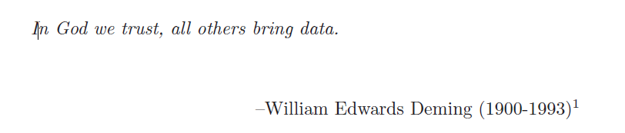
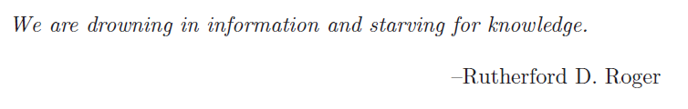
The Importance of Bernoulli’s Principle of Insufficient Reason for Data Scientists
“A principle that was first enunciated by Jakob Bernoulli which states that if we are ignorant of the ways an event can occur (and therefore have no reason to believe that one way will occur preferentially compared to another), the event will occur equally likely in any way.”
Consider the implications of this principle in an organizational decision making setting where all possible alternatives are considered equally likely or equally valuable.
What is the probability of following a poor course of action?
What is the probability of wasting resources by following ineffective paths of action?
We need to adopt an approach that is the most economical for finding the “truth” and providing “information gain”. This approach is referred to as the scientific method.

Slide 23
Peirce’s Trichotomy of the Scientific Method
As Self-Correcting Cycles Leading to the “Truth”
Multiple
Hypotheses
Abductive
Reasoning
Begin Next Cycle with Convergence on “Truth”
What are Testable Conclusions About Other Phenomenon That Must Be Reached For Each Hypothesis if True?
Controlled Experiments Based Upon Samples From a Population
Explanatory
Hypotheses
Experience
What Must
Happen If True?
Deductive
Reasoning
Begin Research
Assess Results of Application and Adjust Hypotheses
A Question
Sufficient Accuracy Reached to Take Action
Elimination
of False Hypotheses
(retroduction)
Test Predictive
Models
Execute Actions
Inductive
Reasoning
Assess Accuracy
reflects imaginative interpretation of results.
Economics Plays a Role in Sufficiency Decision.

Slide 24
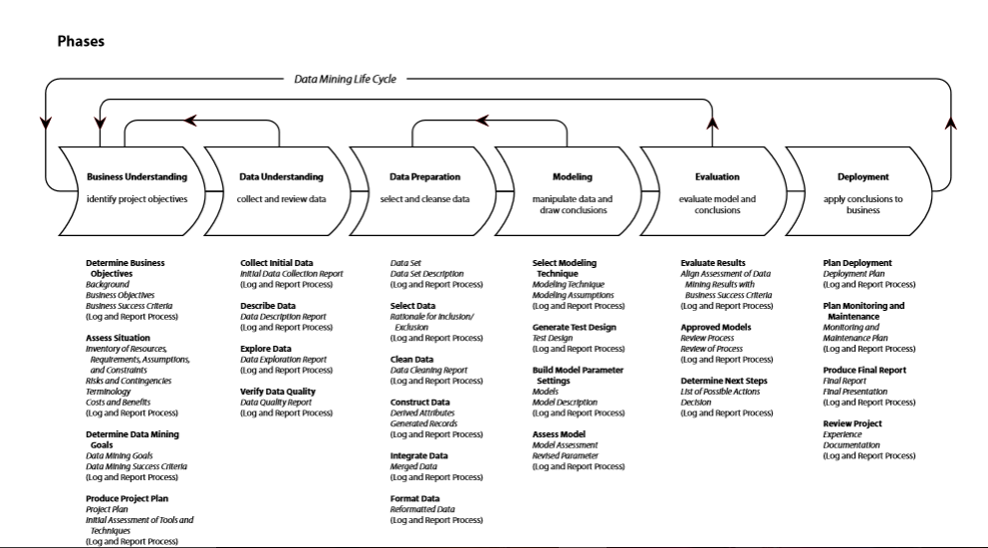
The CRISP-DM Project Development and Deployment Methodology

Slide 25
The CRISP Life Cycle Is Actually Two Life Cycles
Objectives
Production
Data and Process Mining
Unit Test and UAT
Data Discovery and Algorithm Development
Machine Learning
Solution Deployment
Device
Tested
Code (Typically C, C+)

Slide 26
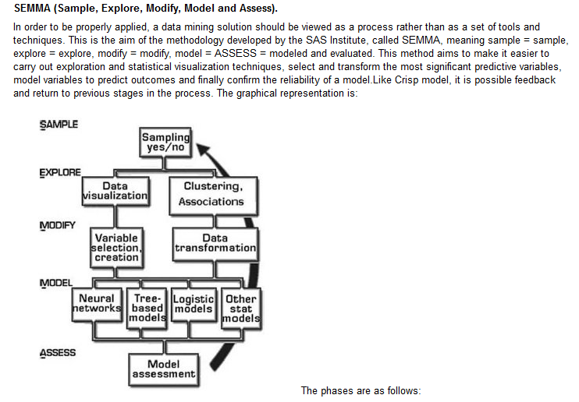

Slide 27
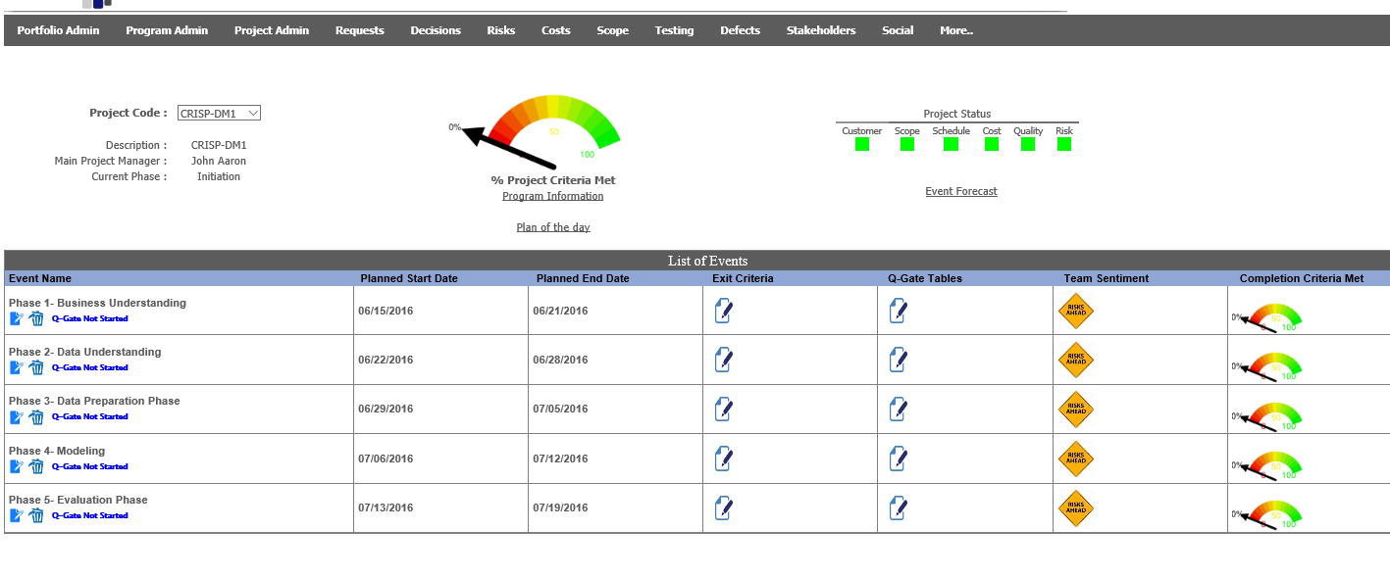
Using PRIMMS Project Management Tool For Methodology Guidance and Project Tracking

Slide 28
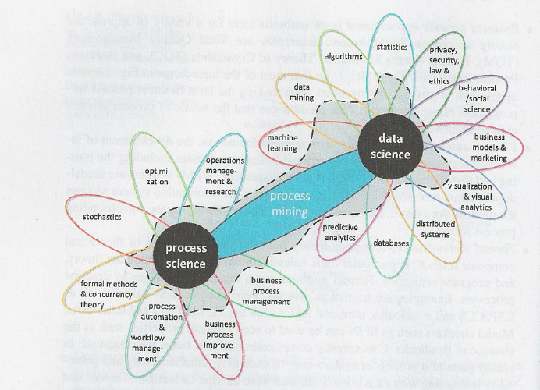

Data Science and Process Science Are a Powerful Combination Leading to Enterprise Value Creation
DMAIC
Six Sigma
CRISP-DM

Slide 29
Process Improvement Methodologies
A key performance indicator (KPI) is a value used to monitor and measure effectiveness and efficiency. Although some, like net profit margin, are nearly universal in business, most industries have their own key performance indicators as well. KPI’s should always be measured independently from the research process.
Six Sigma is a mature methodology for improving KPI’s that are tied to defects and quality. The approach emphasizes the attainment of improvement through defect removal and statistical control using samples of population data.
CRISP-DM is a mature methodology for improving KPI’s that are tied to solution deployment. CRISP-DM can be used for growth, discovery of opportunities and innovation given some modifications. The approach emphasizes the mining of existing observations of multi-dimensional, often complete population datasets to uncover causation. Then systems are deployed enabling the user to act upon causal factors in order to achieve competitive advantage for the organization.

Slide 30
Lean Six Sigma Brings an Action and Business Value Orientation
Examples
Align project with business goals and the VOC, and establish accurate metric baselines.
Ensure buy-in from process owner, finance and other stakeholders.
Communicate the project to stakeholders.
Ensure measurement system accuracy, collect data on inputs and outputs and prove the causal effect Y=f(X) using Lean Six Sigma tools and methods.
Improve measurement systems and refine analyses as needed to identify root causes and their solutions, that is, improvements or counter measures.
Select best alternative solution. Develop a detailed improvement plan and conduct a pilot study to prove that Y=f(X).
Integrate solutions into larger process based upon pilot study.
Create standardized procedures, processes and mistake-proofing.
Implement training and audits to sustain the solutions.
Create the control plan, apply control strategies, and transfer project ownership to the process owner and local work team.

Slide 31
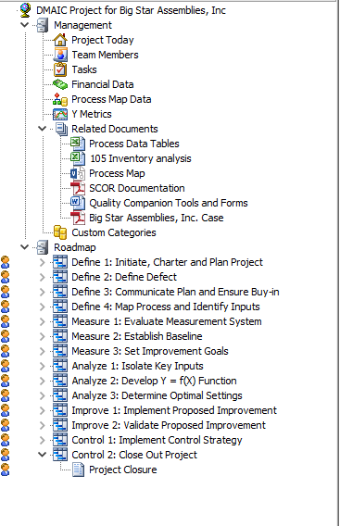
Six Sigma Projects Can Take A Very Long Time To Show Results
Tend to Focus on Customer Satisfaction By Resolving Quality Problems
Tend to Not Be Forward Looking For Value Opportunities Based Upon Growth
Tend to Ignore Discovery

Slide 32
Example
Inventory and On Time Delivery
Unpredictable demand and process performance leads to high inventory which leads to high costs and poor On Time Delivery performance to customers.
Is there a better way to predict events even with millions of different parts?
→
Sales
Make
Deliver
Return
Source
Time

Slide 33
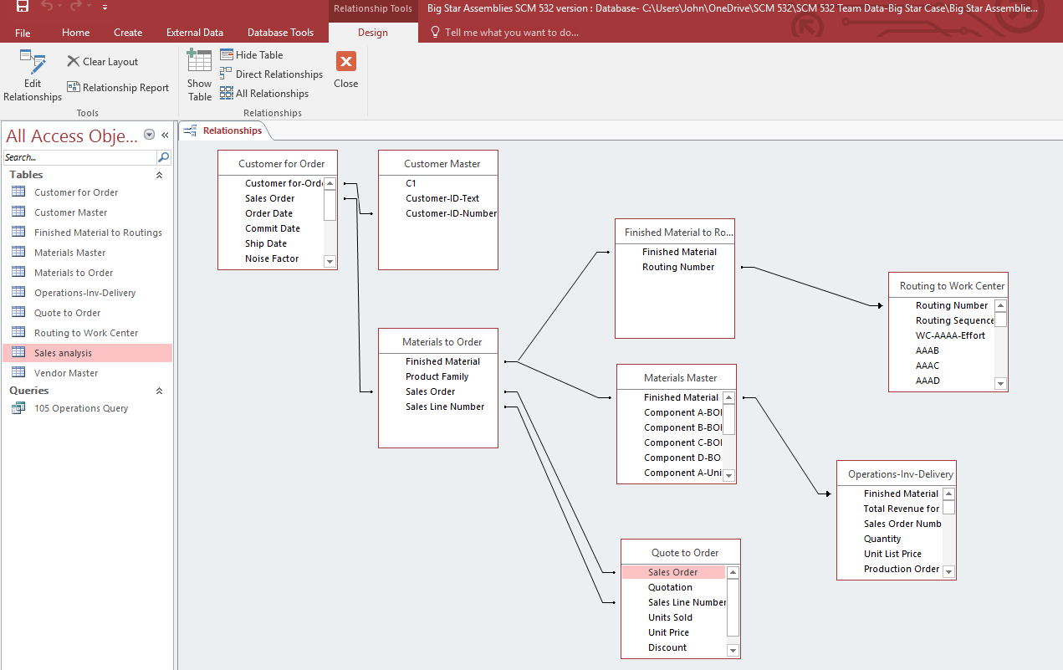
Instructor’s Big Star
Dataset

Slide 34
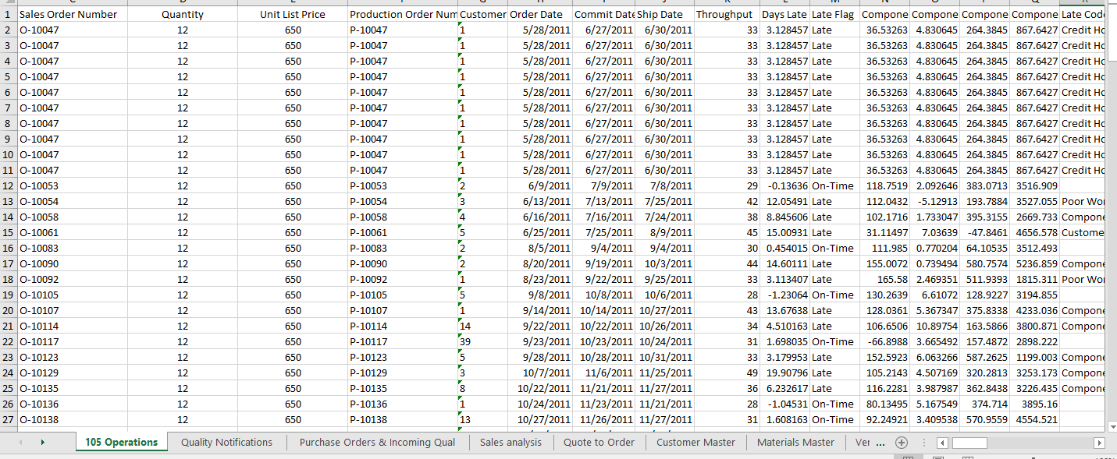
Sample Query Output Producing Structured Data

Slide 35
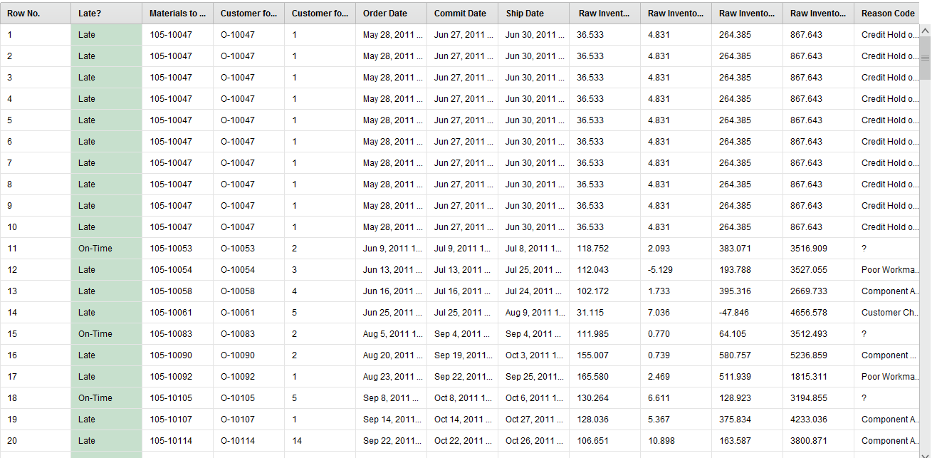
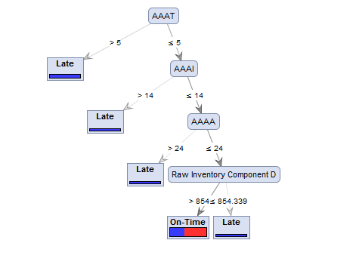
Example Continued
Raw Data From IT System
Data Mining Quickly Uncovers Sources of Variation to Specific Work Centers and a Vendor
Y=f(X) Step of Six Sigma

Slide 36
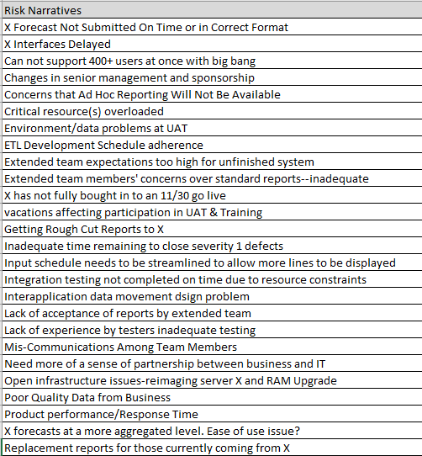
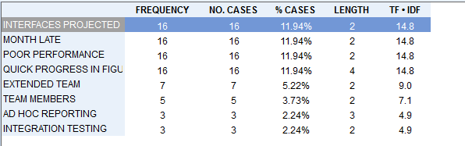
Example of Text Analytics
Projects or Customer Service Applications

Slide 37
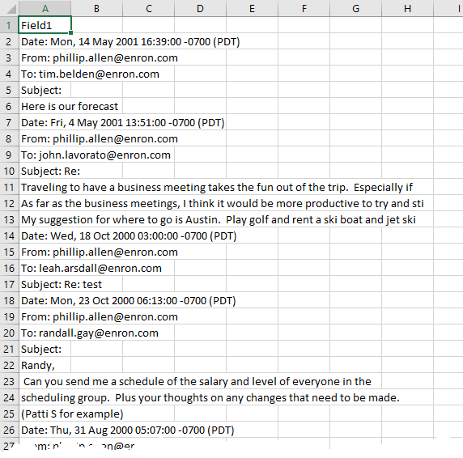
We will also explore text analytics and use a portion of the Enron email dataset available from Kaggle.

Slide 38
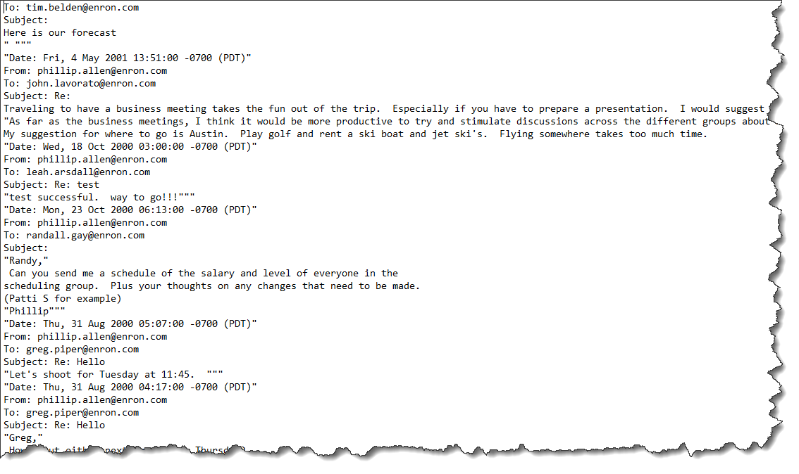
Email Example of Text Unstructured Data

Slide 39
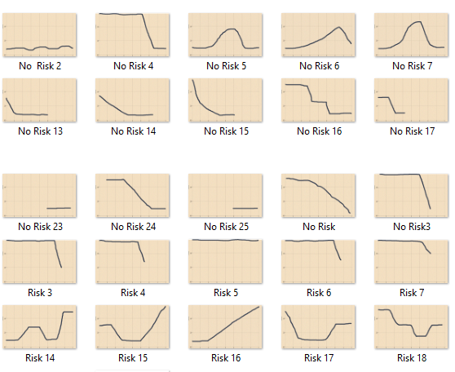


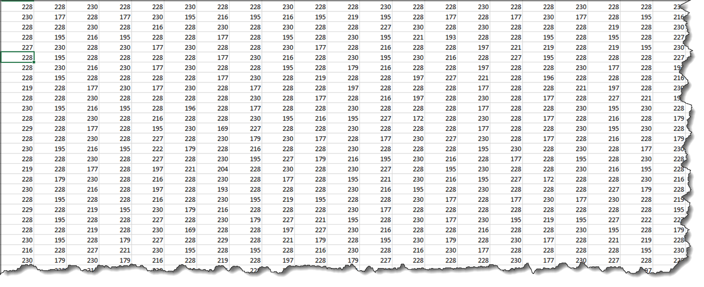

Using Image Time Series Data

Slide 40
Another Example : Data Mining Improving Productivity of a Sales Force
CRM tools are useful for improving the productivity of a sales force. But how does one translate a software application into effective execution?
→
Sales
Make
Deliver
Return
Source
Time

Slide 41
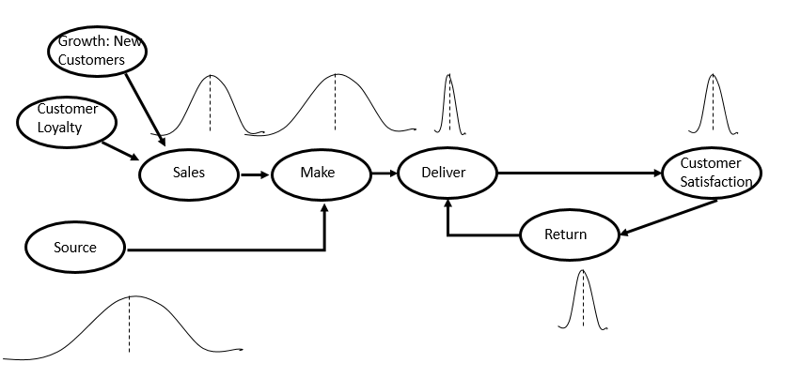
Mining and Modeling
Key assumption of discovery of Y=f(X) where information, possibly new insights, drives change that lead to improvement on KPI’s.

Slide 42
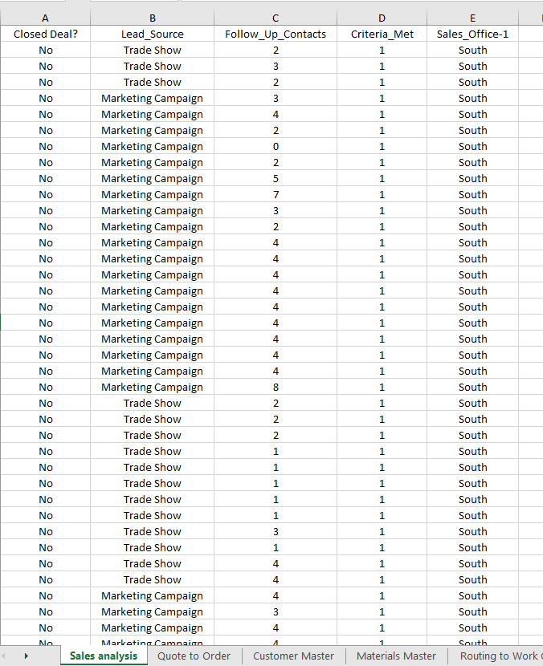
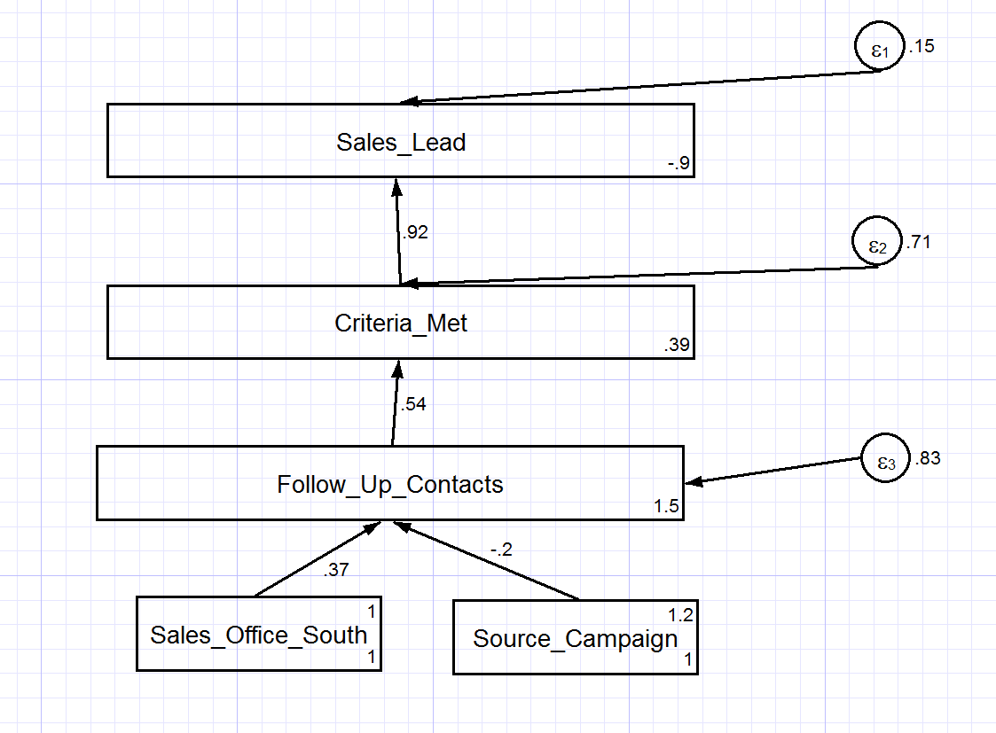
Example 3 Continued
Raw Data From CRM
Data Mining Quickly Identifies Models Explaining Drivers of Sales Performance
Closed_Deal? Yes/No
And when we add the scientific method plus project management to the approach……..

Slide 43
Peirce’s Trichotomy of the Scientific Method
As Self Correcting Cycles Leading to the “Truth”
Multiple
Hypotheses
Abductive
Reasoning
Begin Next Cycle with Convergence on “Truth”
What are Testable Conclusions About Other Phenomenon That Must Be Reached For Each Hypothesis if True?
Controlled Experiments Based Upon Samples From a Population
Explanatory
Hypotheses
Experience
What Must
Happen If True?
Deductive
Reasoning
Begin Research
Assess Results of Application and Adjust Hypotheses
A Question
Sufficient Accuracy Reached to Take Action
Elimination
of False Hypotheses
(retroduction)
Test Predictive
Models
Execute Actions
Inductive
Reasoning
Assess Accuracy
reflects imaginative interpretation of results.
Economics Plays a Role in Sufficiency Decision.

Slide 44
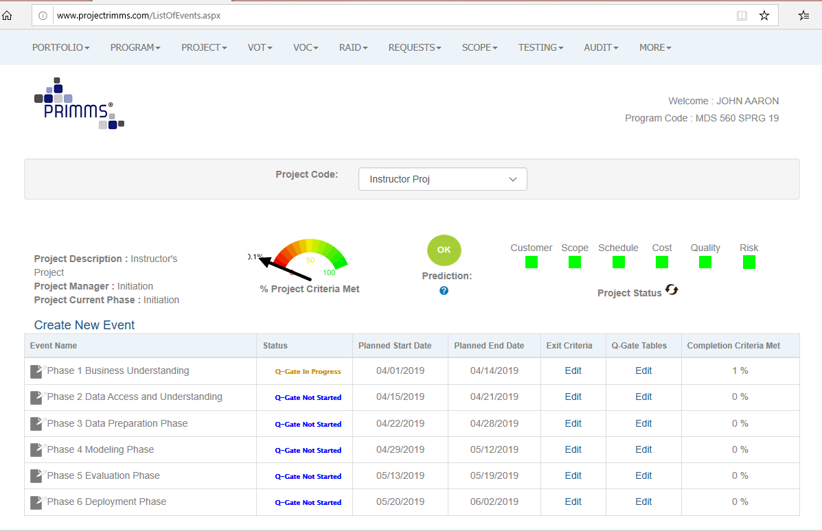
Using PRIMMS Project Management Tool For Methodology Guidance and Project Tracking

Slide 45
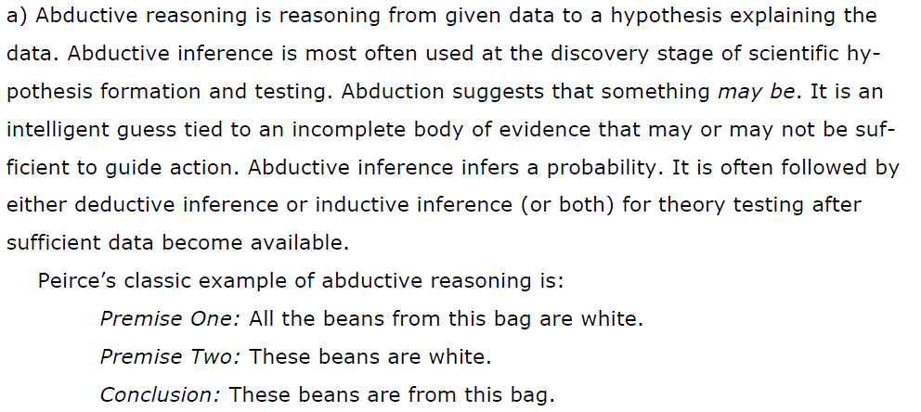
Abductive Reasoning-A Useful Starting Point

Slide 46
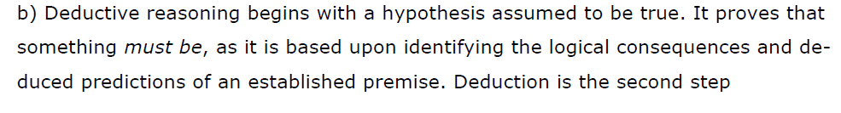
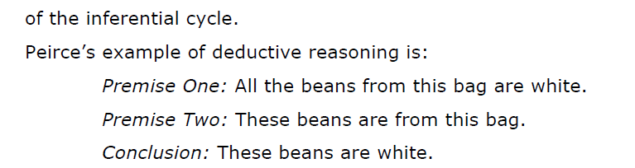
Deductive Reasoning—The Workhorse of Mathematical Logic

Slide 47
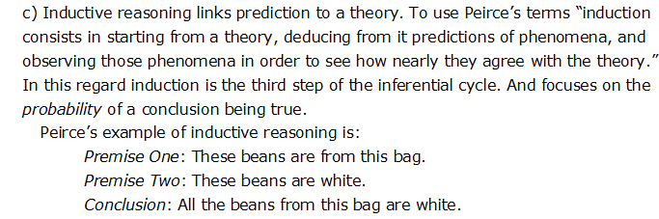
Inductive Reasoning—A Key Tool for Predictive analytics

Slide 48
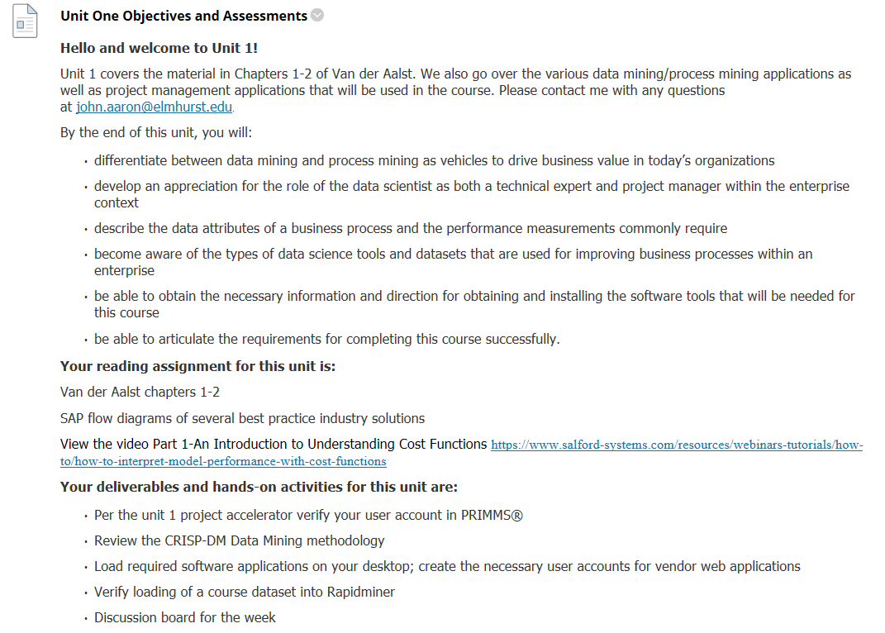
This Week

Slide 49
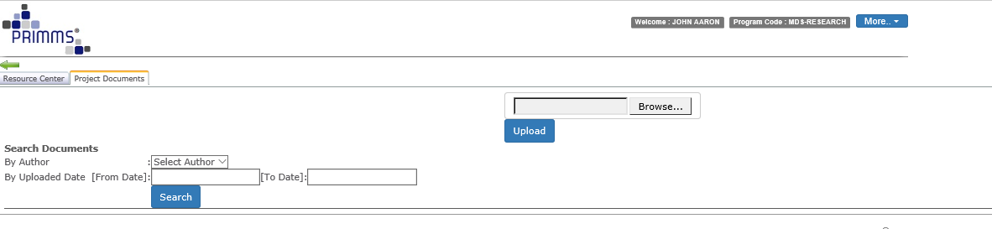
Storage of Weekly Assignments (Documents)

Slide 50
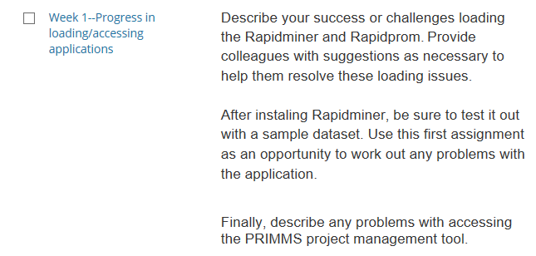
Discussion Board—Week 1

Slide 51
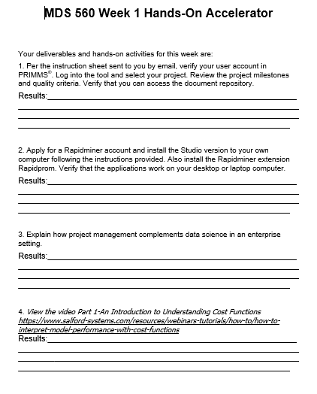
You will need the studio version, not the free trial version.

Slide 52
Appendix

Slide 53
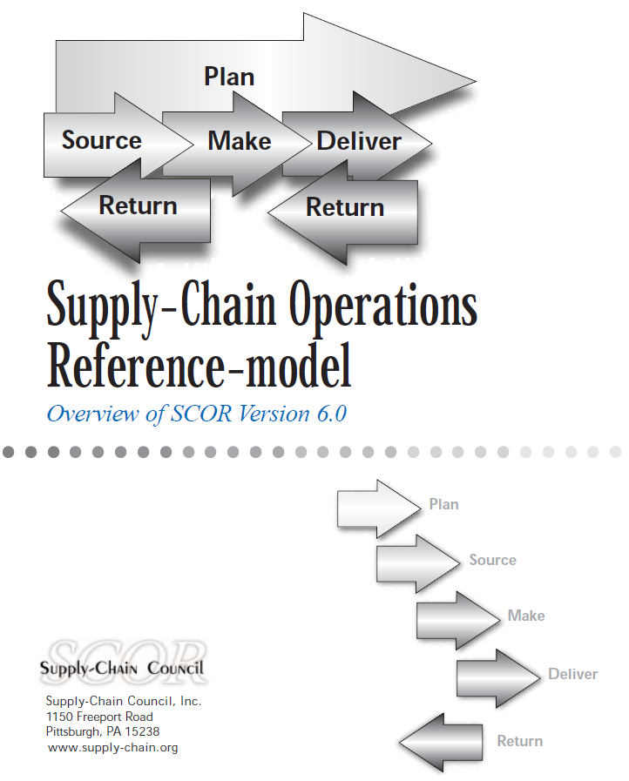

Slide 54
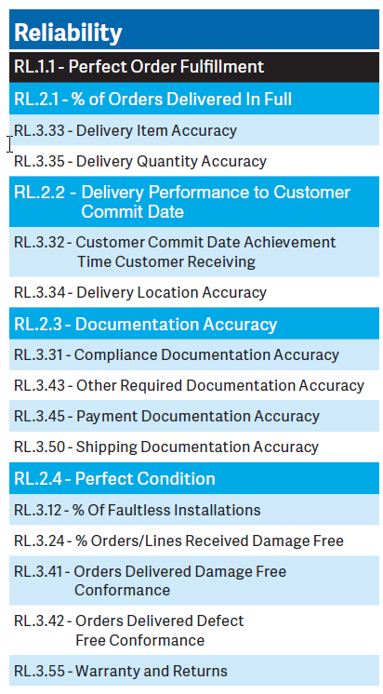
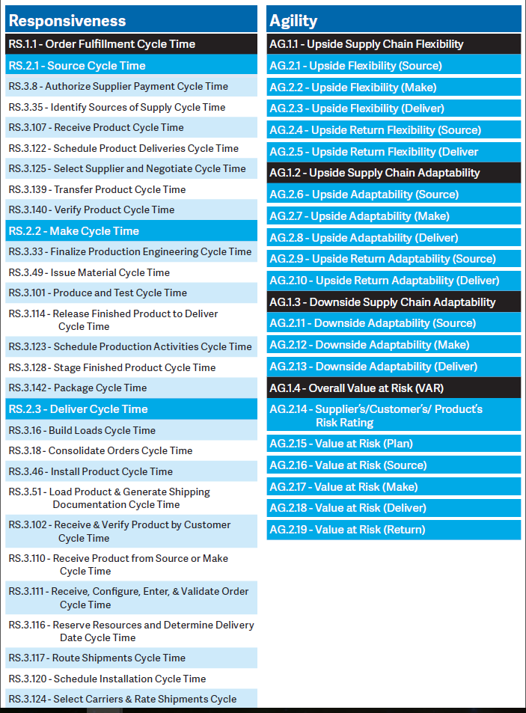

Slide 55
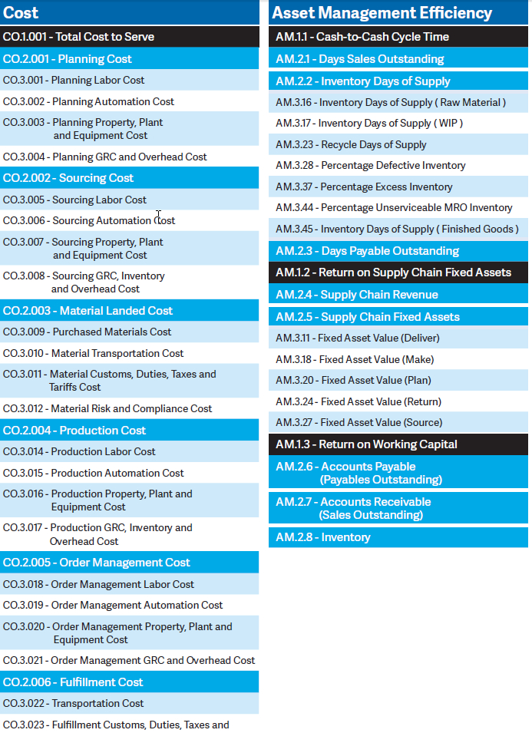

Slide 56
Common Lean Six Sigma Projects
Functional Area | Problem Category
Finance | Accounts payable cycle time
 | Variance to budget
 | Margin improvement
 | Overtime expense
 | Accounts receivable cycle time
Quality Assurance | Defects
 | Customer complaints
 | Claims
 | Rework
 | Scrap
 | Warranty
Billing | Billing errors
 | Mailing Expense

Slide 57
Functional Area | Problem Area
Call Center | Average Handling Time
 | Call Transfers
 | Cost per abandoned call
Purchasing | Inventory Investment and Turns
 | Year over year cost reduction
 | Number of Suppliers
 | Cost per invoice
 | Purchasing errors
Administration | Utilities expense
 | Insurance costs per employee
 | Facility costs per employee
 | Material and supplies expense

Slide 58
Functional Area | Problem Area
HR | HR staff per total employees
 | Absenteeism rate
 | Training hours per employee
 | Employee cost to hire and retain
 | Health costs per employee
 | Lost time accidents
 | Disability costs
 | HS&E
IT | System Capacity
 | System Incidents
 | Outage Durations

Slide 59
Functional Area | Problem Category
R&D | Worker hours per project
 | New products per year
 | Current projects
 | Project cycle time
 | Projects waiting
 | Engineering changes per year
Distribution | Number of shipments
 | Freight charges (inbound and outbound)
 | Inventory investment and turns
 | Excess and obsolete inventory
 | Shortages
 | Premium freight costs
 | Returned product
 | Product transfer between facilities
 | On time delivery

Slide 60
Functional Area | Problem Category
Marketing and Sales | Sales dollars per sales person
 | Turnover per customer
 | Marketing cost per dollar sales
 | Percentage of sales closed
 | Quote to actual project cost
 | Order changes
 | Sales policies and procedures
Operations | Lead Times
 | Late Orders (on time delivery)
 | Average cycle time per order
 | Scrap
 | Rework
 | Emergency maintenance

